Slide 1

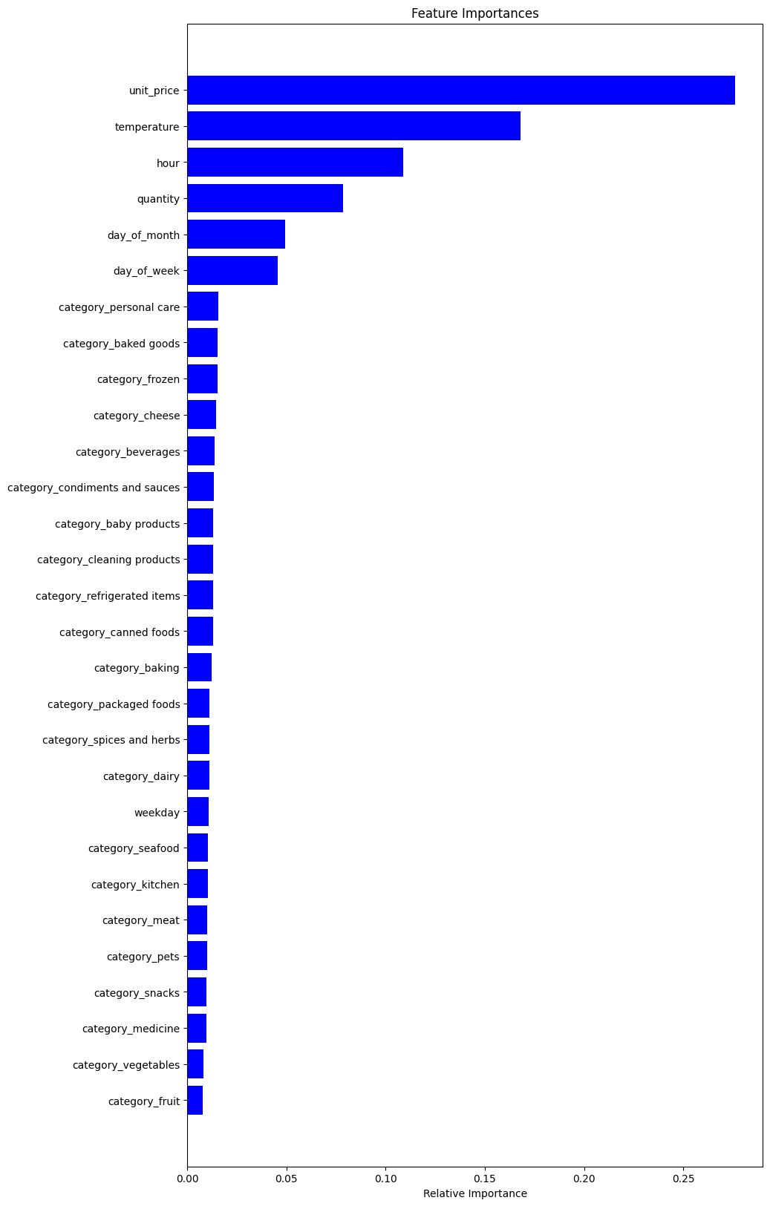
Objective: Predict stock levels hourly using sales and sensor data to optimize product procurement.
Model Used: RandomForestRegressor, known for handling complex data interactions.
Performance: Evaluated using Mean Absolute Error (MAE); lower MAE indicates better accuracy.
Business Impact:
Forecast Accuracy: Provides reasonable stock level predictions. Product categories aren’t very important.
Inventory Management: Helps in reducing overstock and stockout.
Unit price (<30%) and temperature(<17%) are important factors.
Procurement Optimization: Facilitates smarter, data-driven procurement decisions. Hour of the day (<12%) is important.
Conclusion: The model demonstrates potential to significantly improve inventory and procurement strategies. Accurate predictions can lead to cost savings by better aligning supply with demand.
Summary of Results

